Slide 1


PES
UNIVERSITY
Problem solving in C Laboratory (UE19CS152)

Slide 2
PROJECT TITLE
CUSTOMER BILLING SYSTEM
(PROJECT NO. 11)

Slide 3
PROJECT TEAM MEMBER
Abu Sufian (PES1UG19CS024)
Varun (PES1UG19EC343)
Shreenivas (PES1UG19EC285)
Samarth Kumar (PES1UG19CS424)
PROJECT GUIDE NAME
NITHIN

Slide 4
ARCHITECTURE DIGRAM
Customer
Shopkeeper
New Customer
Old Customer
Add Items
Delete Items
Bill
Display
Edit Items
Display customer

Slide 5
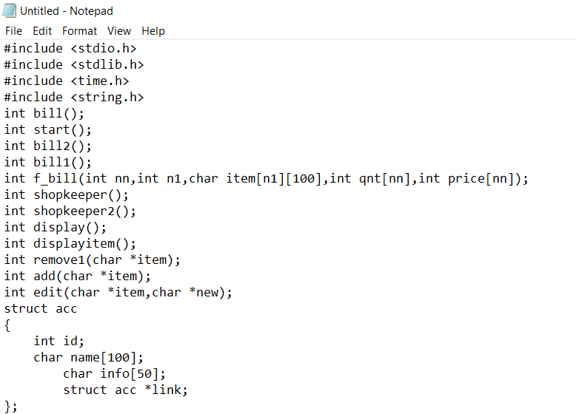
We are using data structure in the code.
These are the function we are going to use in the code.

Slide 6
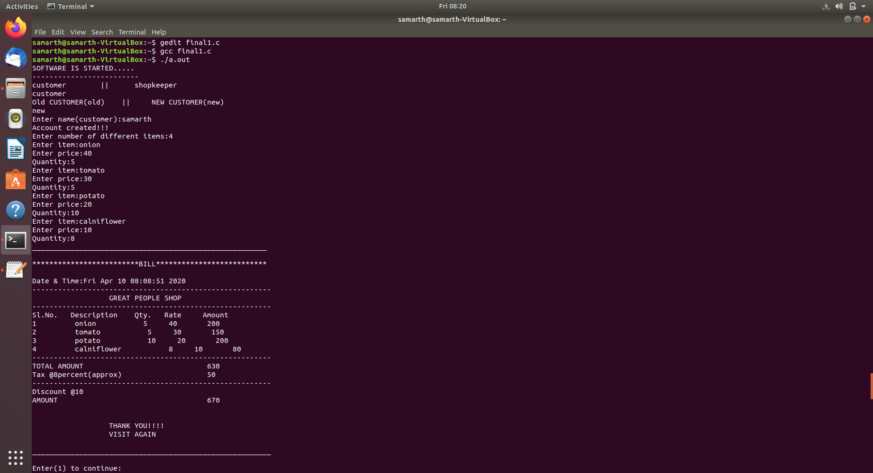
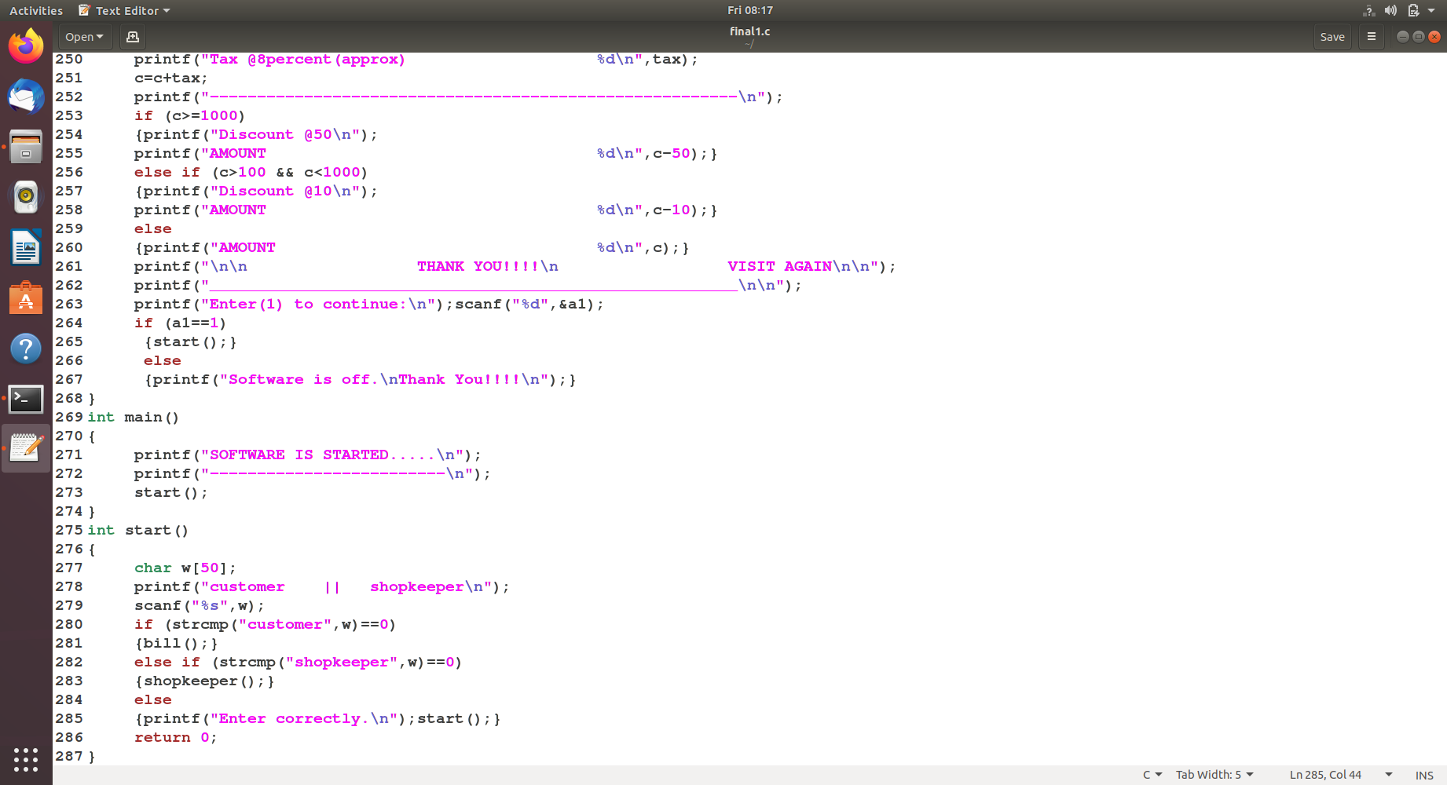
Project is started is by asking two option ( customer || shopkeeper )

Slide 7
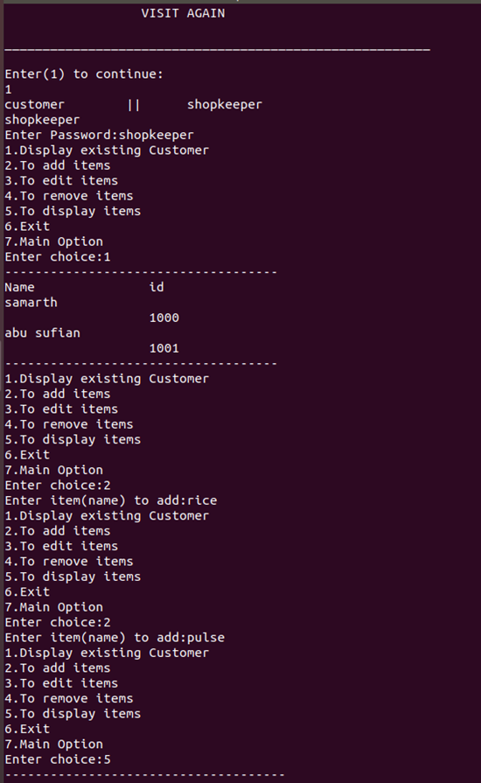
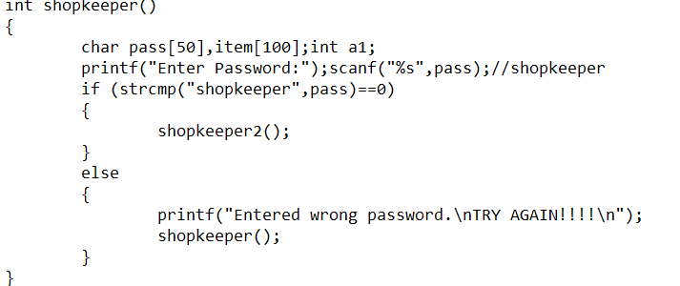
Suppose we have shopkeeper an option shopkeeper.
Then it ask password that password is shopkeeper.

Slide 8
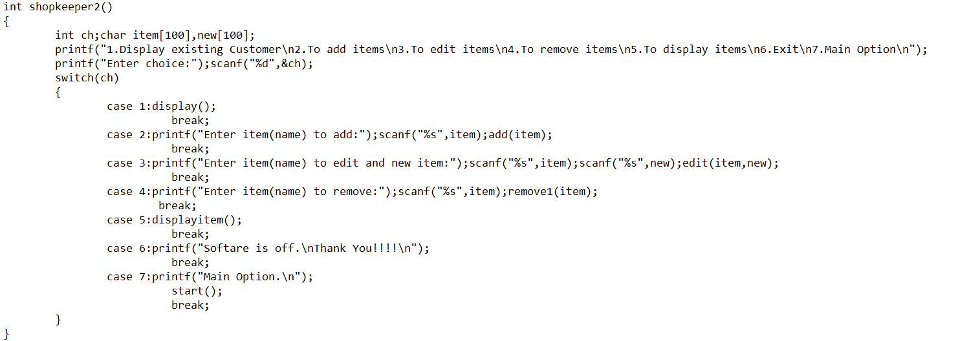
In shopkeeper 2, there are seven functions.
1.display() → for display exsiting customer.
2.add() → add items
3.edit() → edit items(type old item, new items)
4.remove1(item) → remove items.
5.displayitem() → display items.
6. If we type 6 option, then it is closed.
7.start()→ it goes to starting part of code.

Slide 9
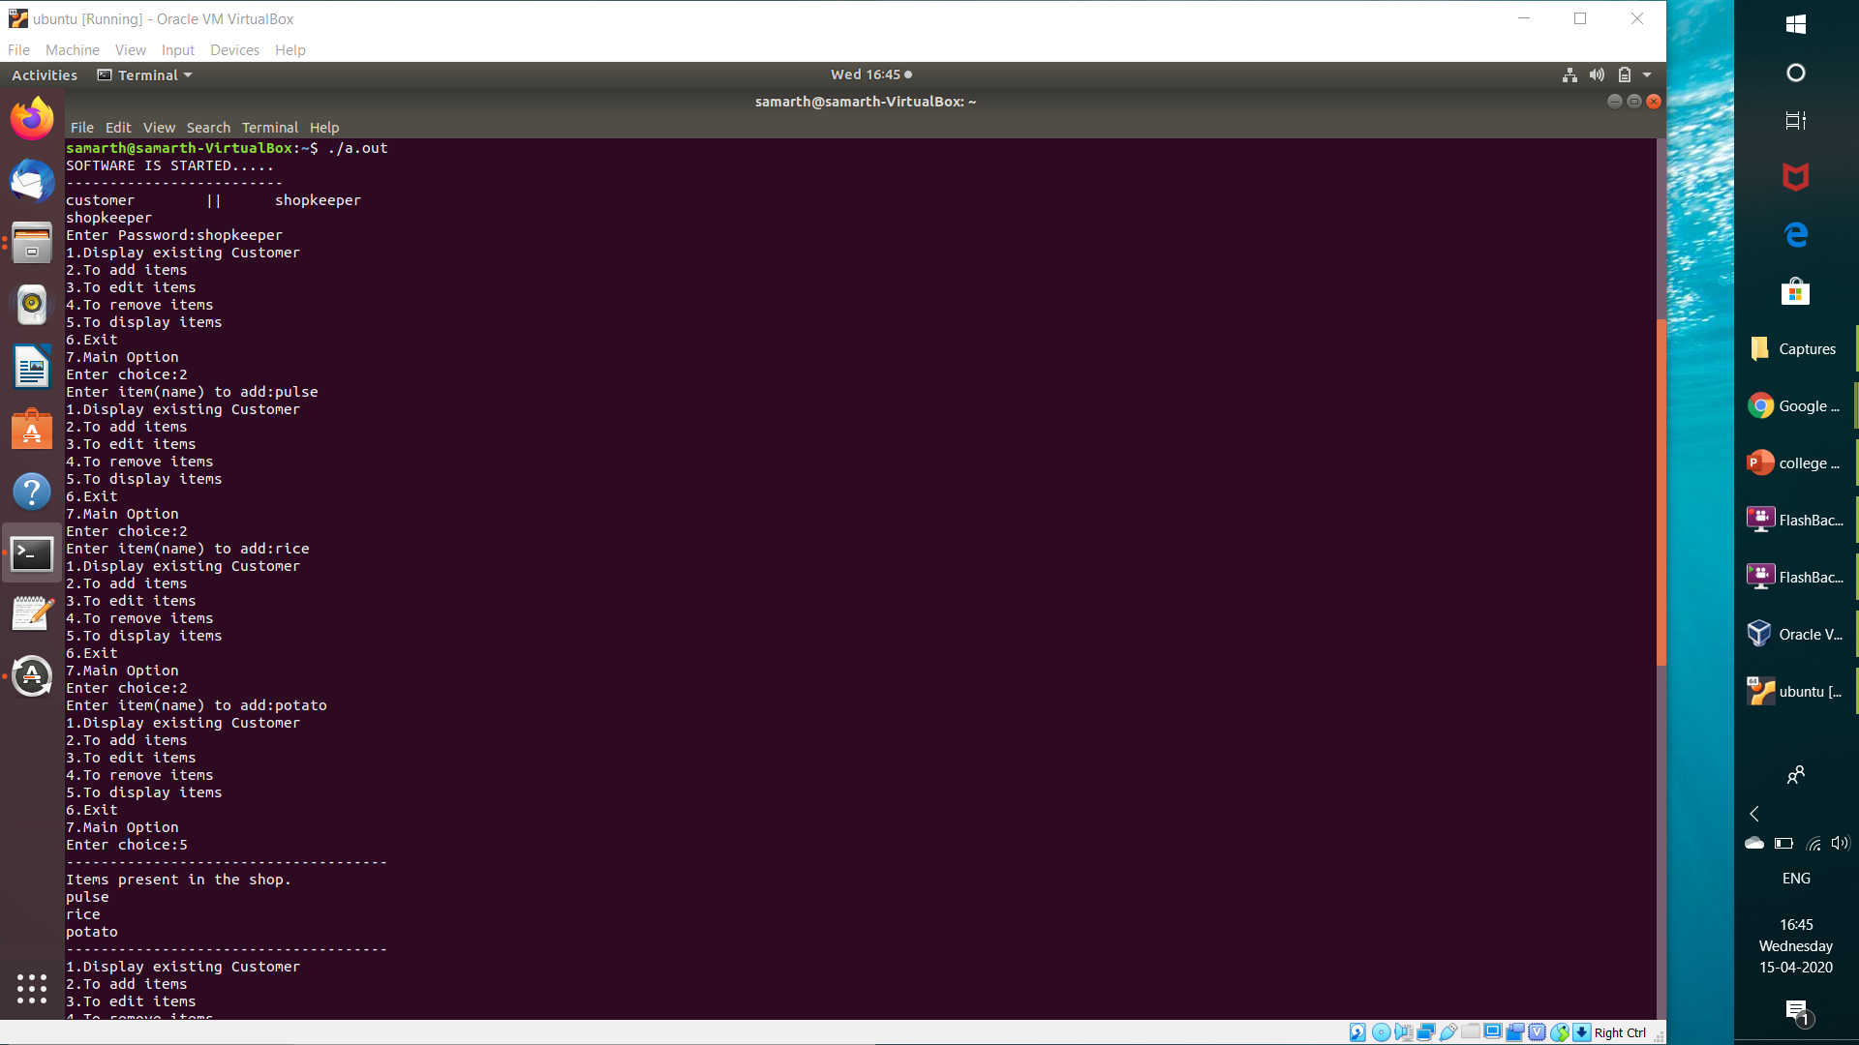
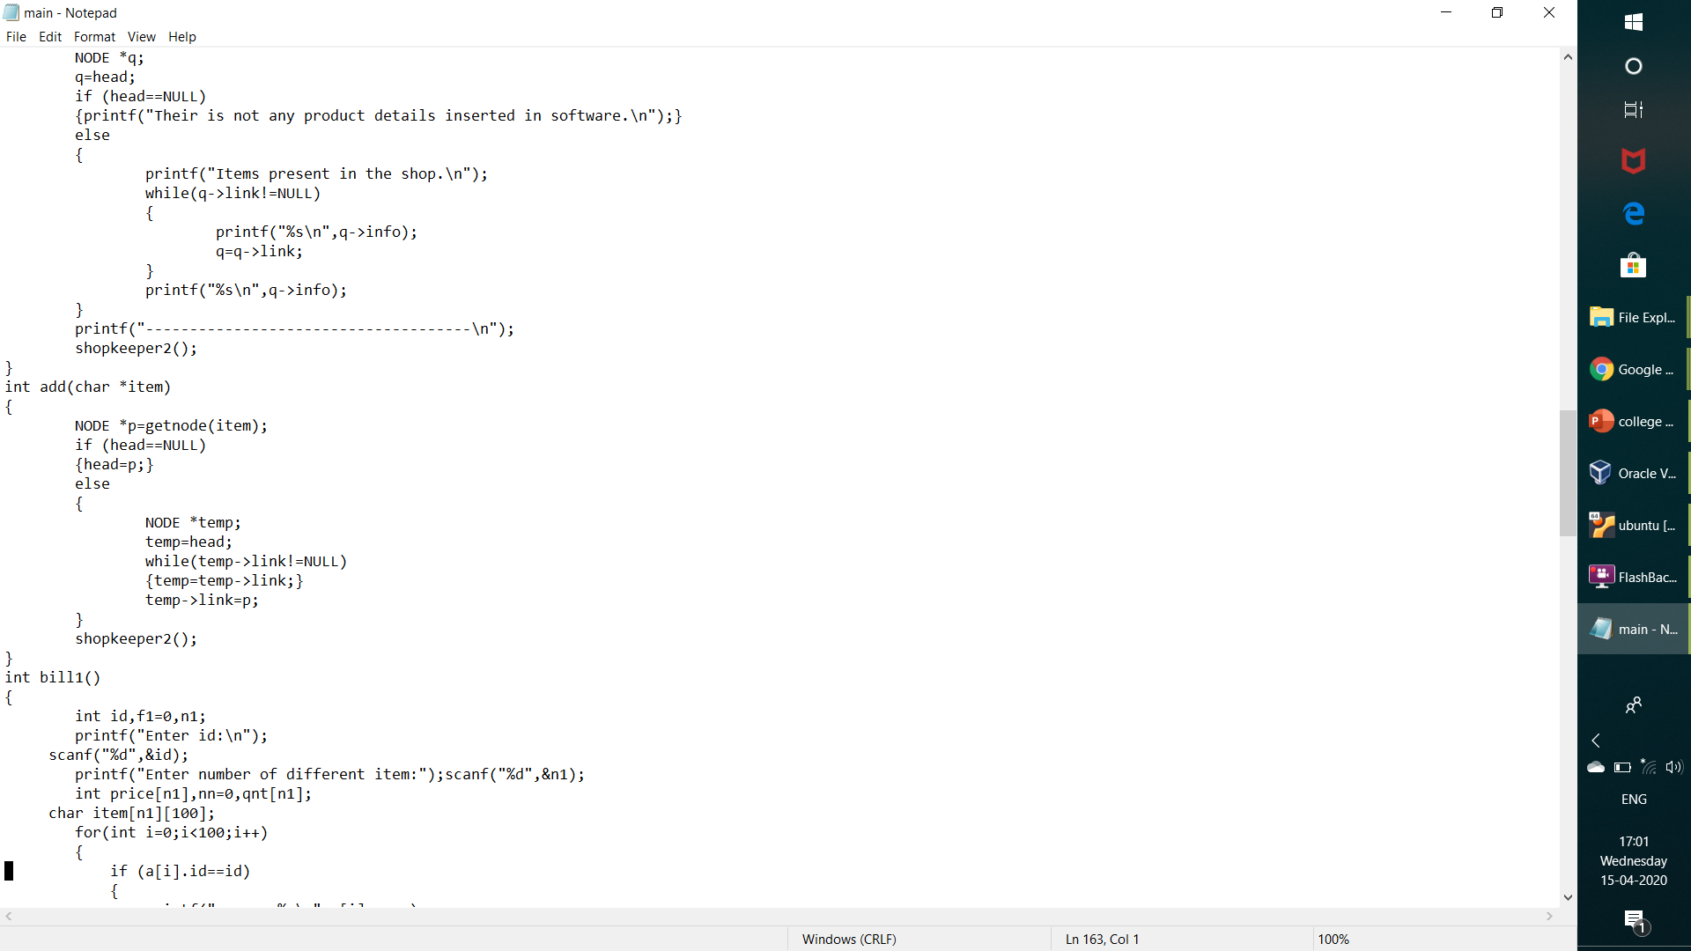
add()

Slide 10
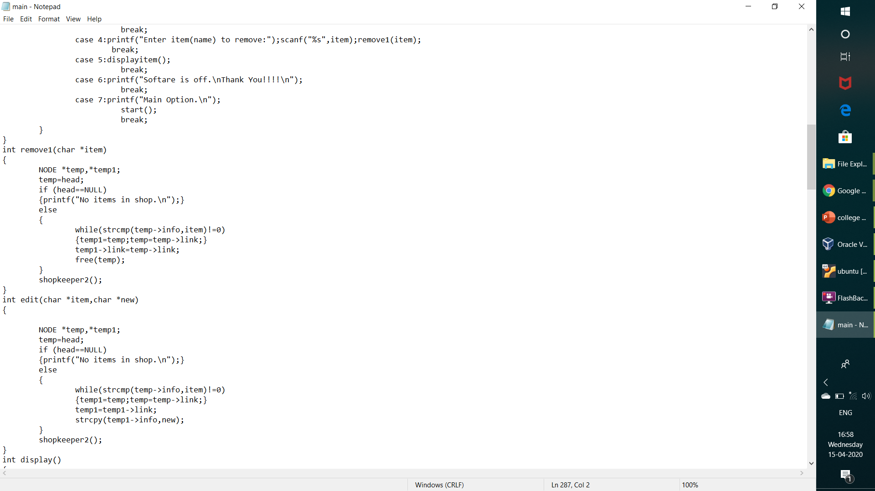
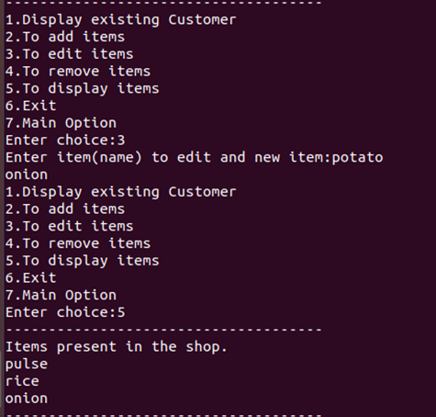
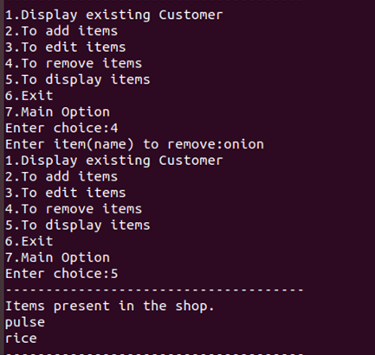
edit()
remove1()

Slide 11
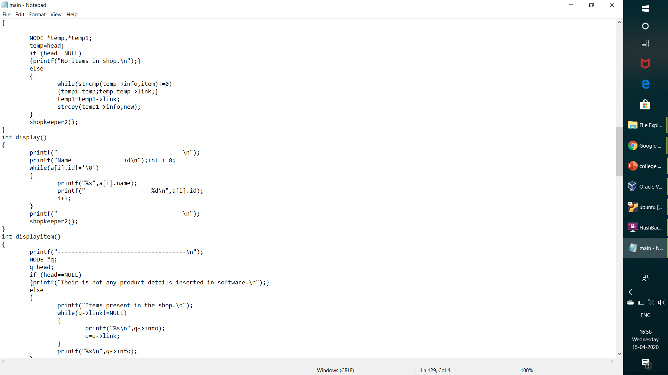
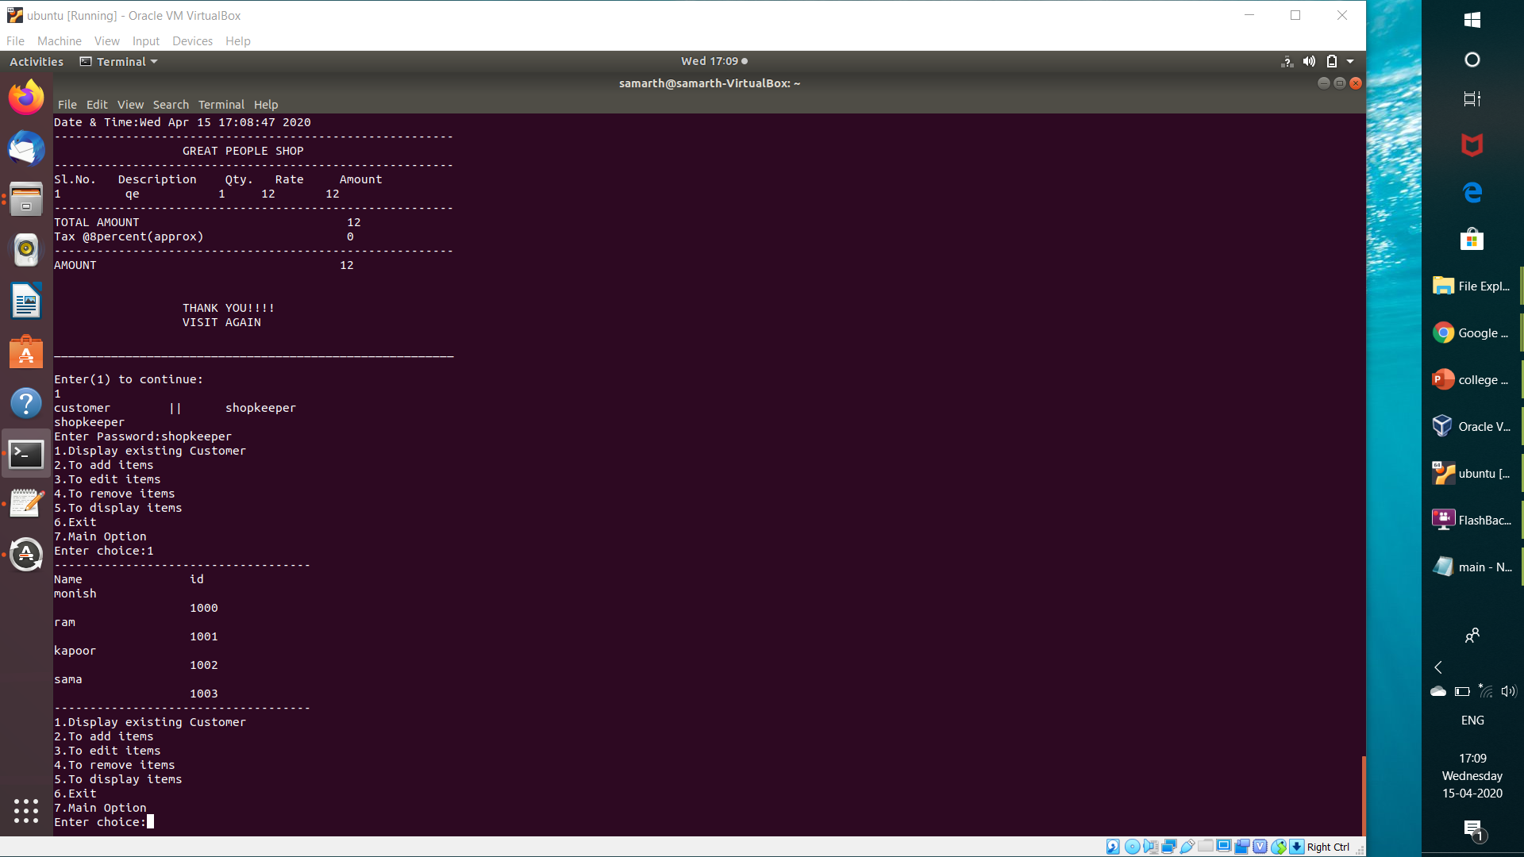
display()

Slide 12
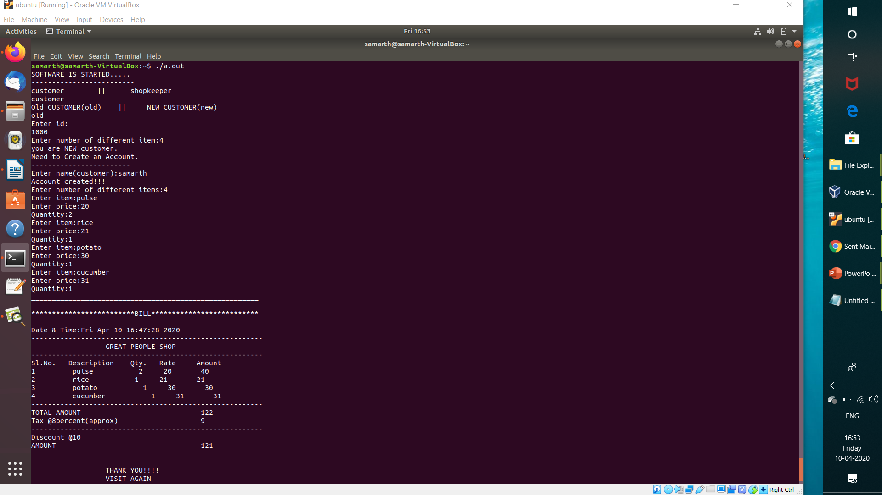
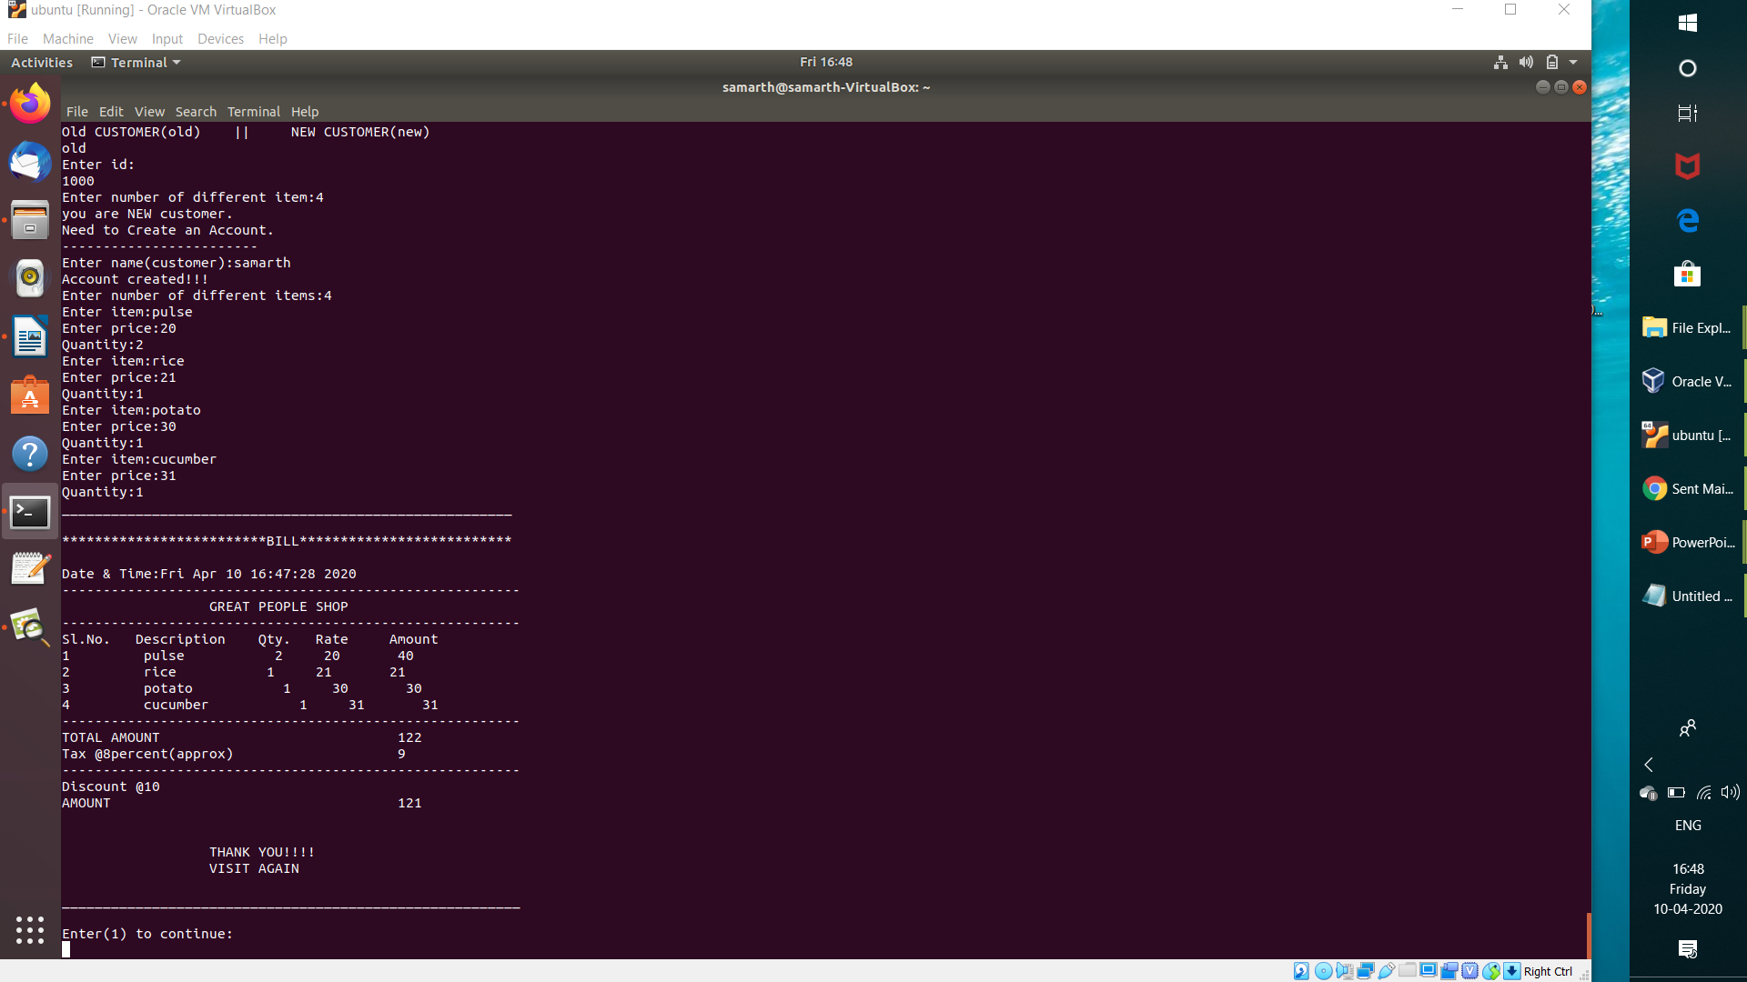
If we type customer option .
Next option (Old customer (old )|| New customer(new))
IF you are not an old customer and you type old then it will first create your account.
You have to type only your name.
First person whose is created has customer id is 1000.
As the customer is increasing in the shop, customer id is increased by 1.
Then at last bill is generated.
If you want to continue then type 1.

Slide 13
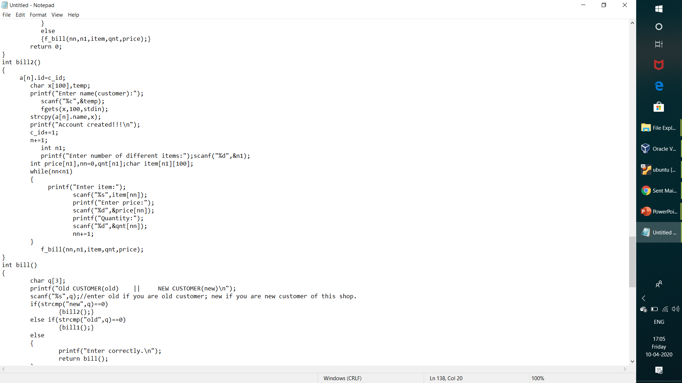
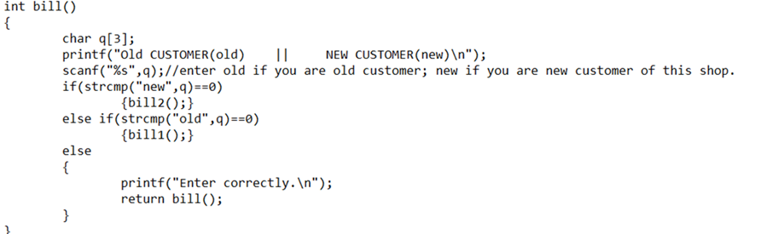
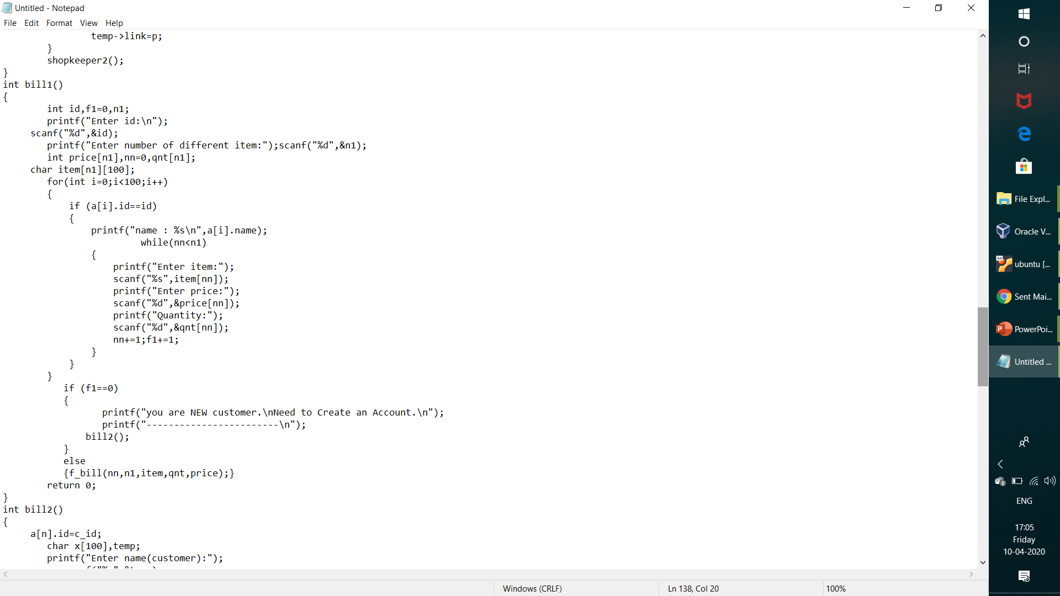
bill2()
When we go through customer option , four function came in use.
1.bill() → contain old or new customer option.
2.bill1() → contain related to old customer.
3.bill2() → contain code related to new customer.
4.f_bill() → contain code related to bill generation.
bill()
bill1()

Slide 14
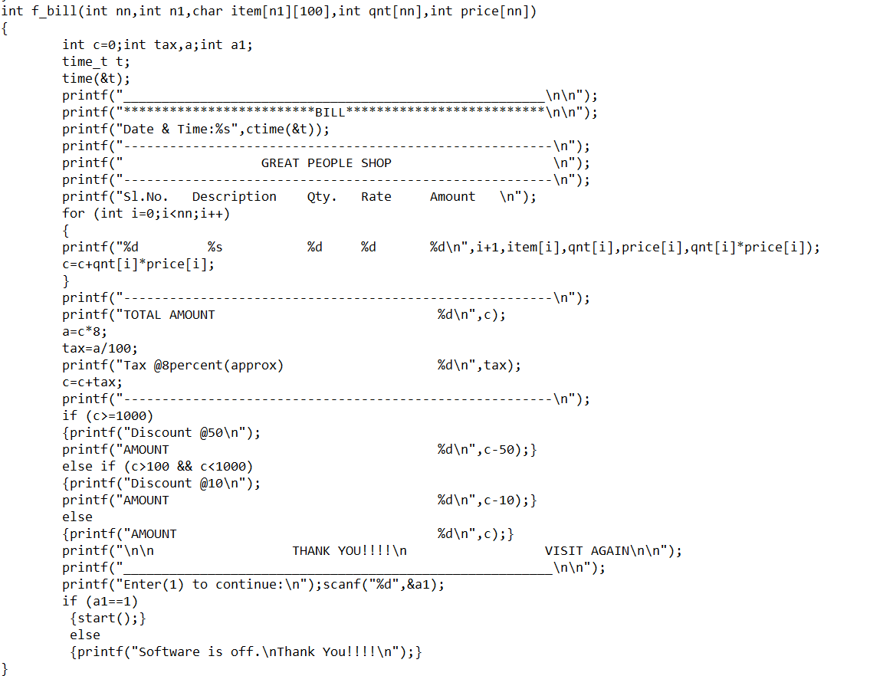
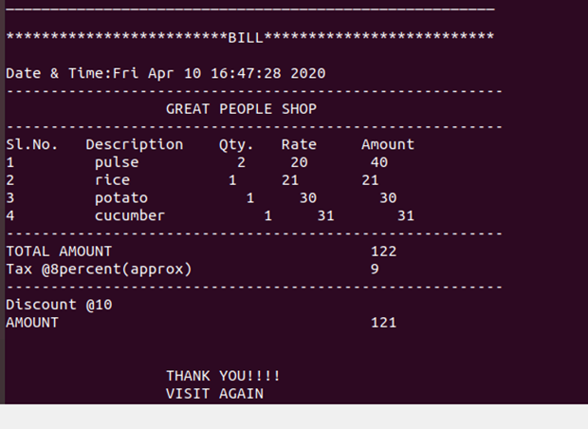
f_bill()

Slide 15






Slide 16
EXECUTION OF
CODE

Slide 17
THANK YOU

